Slide 1

Radio spectrum for present and future rail transport needs
Vincent Durepaire
WG FM Vice-chairman & FM56 Chairman
ANFR - European Affairs

Slide 2
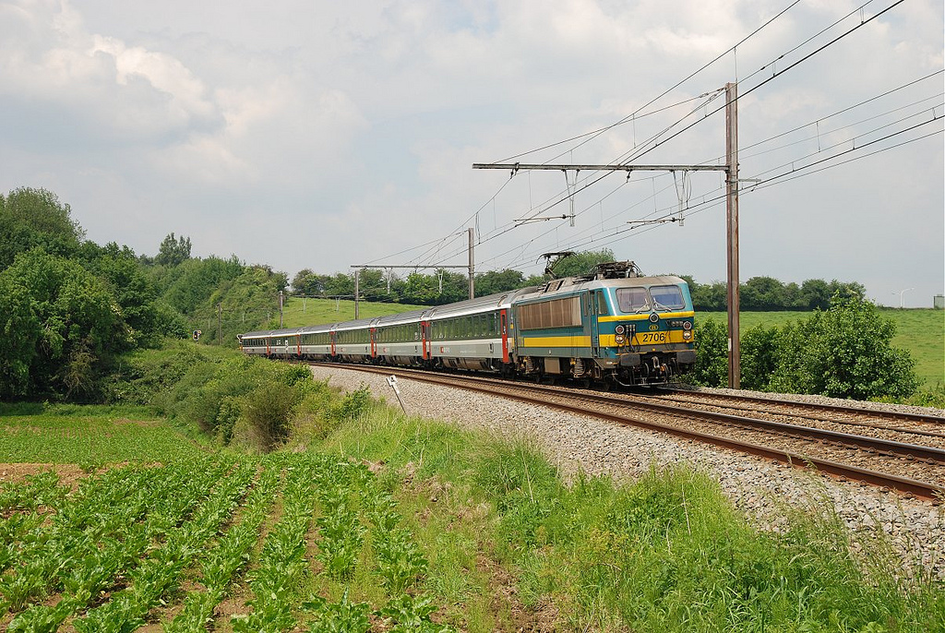
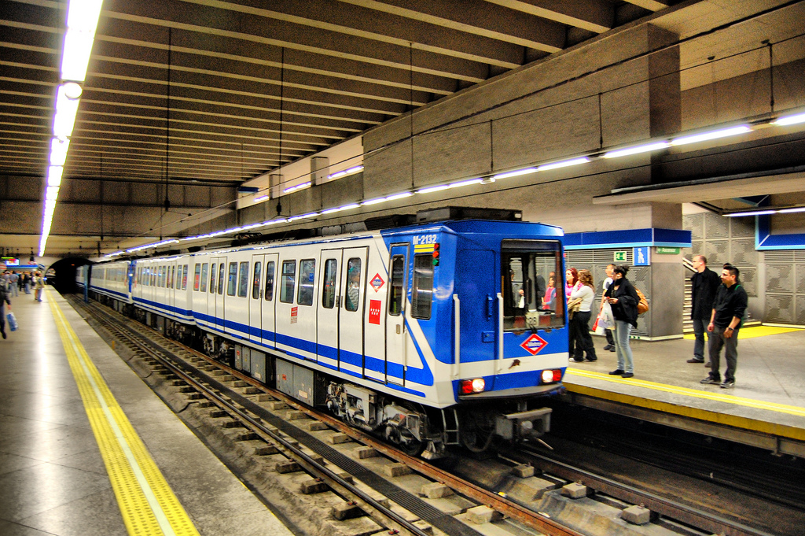
Interoperable trains
Voice + ETCS
Urban Rail
CBTC
source
source

Slide 3
Radio spectrum for the present of RMR
Today 876-880 MHz / 921-925 MHz harmonised for RMR
    2x4 MHz for GSM-R only
    Commission Decision 1999/569/EC
    ECC/DEC/(02)05
    MFCN above 925 MHz  remember ECC Report 229 and GSM-R improved cab-radios as per TS 102 933-1 v1.3.1 onwards
No harmonisation of 873-876 MHz / 918-921 MHz for RMR
    Only on a national basis
    3 countries so far: Germany, Switzerland and Liechtenstein (rights of use)
RMR = Railway Mobile Radio
umbrella term for GSM-R, FRMCS…

Slide 4
EC Decision on SRD in 874-876 MHz / 915-921 MHz
For vote at RSCOM #64 on 11 July 2018
2x1.6 MHz preserved for railways !
Article 3(4)
    Member States shall refrain from introducing new uses in the 874.4-876 MHz and 919.4-921 MHz sub-bands until such time as harmonised conditions for their use are possibly adopted under Decision No 676/2002/EC.

Slide 5
EC Decision on SRD in 874-876 MHz / 915-921 MHz
Preserved
for FRMCS
GSM-R UL
then FRMCS
Defence / National Decision
SRD in
data
networks
870 MHz
874
874,4
876
880 MHz
RFID
RFID & SRD in
data networks
RFID & SRD in
data networks
Preserved
for FRMCS
GSM-R DL
then FRMCS
916,3 MHz
917,5 MHz
918,7 MHz
Defence / National Decision
Non-specific SRD
802.11ah
915 MHz
917,4
918
919,4
921
925 MHz
Potential sharing
with Defence

Slide 6
Radio spectrum for the future of RMR
Mandate from the European Commission under preparation
    For vote at RSCOM #64 on 11 July 2018
CEPT tasks
    FRMCS spectrum needs (only for critical applications)
    Feasibility of the 900 MHz range while ensuring parallel operation with GSM-R during the migration
    Feasibility of the 1900-1920 MHz band (and further bands if relevant)
    Feasibility to use commercial mobile networks
    Develop harmonised technical conditions
Target date: November 2020 for the response

Slide 7
Organisation of work at ECC
FM56: RMR regulation /
harmonisation
PT1: LRTC derivation for RMR (MFCN as victim)
SE7: RMR as victim
from MFCN and SRD
Bands investigated for harmonisation:
    874.4-880 MHz / 919.4-925 MHz FDD
    10 MHz in the lower part of 1900-1920 MHz TDD
    10 MHz in 2290-2400 MHz TDD as a tuning range

Slide 8
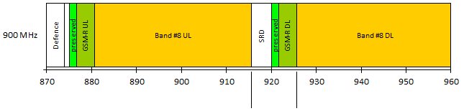
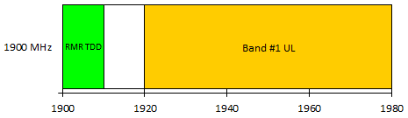
LRTC for RMR based on coexistence with MFCN
RMR BS getting closer to MFCN BS UL band within band #8 duplex gap
duplex gap
RMR BS adjacent to MFCN BS UL band
in-band blocking
RMR TDD
MFCN TDD
Potential synchronisation issue between RMR and MFCN when adjacent
Telemetry and video PMSE are common in the band: see ECC Report 172
2290-2400 MHz
tuning range

Slide 9
Key coexistence studies at 900 MHz
SRD in
data
networks
RMR UL
Band #8 UL
874
874,4
876
impact on BS
880 MHz
RFID
RFID & SRD in
data networks
RFID & SRD in
data networks
RMR DL
Band #8 DL
916,3 MHz
917,5 MHz
918,7 MHz
impact on cab-radios and EDOR
Non-specific SRD
802.11ah
917,4
918
919,4
921
925 MHz
Similarly to ETSI TS 102 933-1 v1.3.1 onwards on improved GSM-R radios, it is expected that FRMCS radios will need to be improved with respect to the receiver characteristics as currently defined by 3GPP for E-UTRA band #8, in order to ensure a sustainable coexistence with MFCN emissions above 925 MHz and SRD emissions below 919.4 MHz.

Slide 10
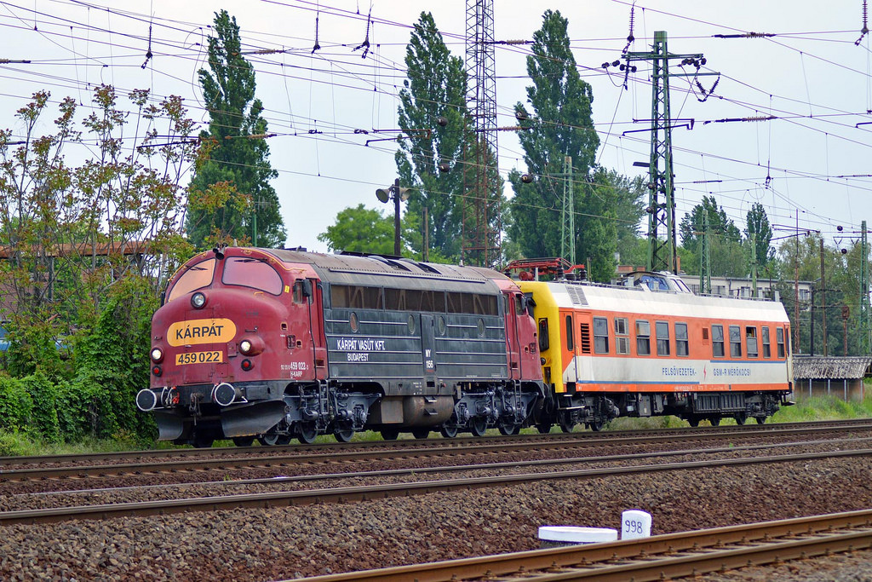
What outage criterion? Key input required
Which criterion? C/(N+I)?
Which threshold? INR?
Which probability? Minimum bit rate?
source
Sens + Margin
Sens + Margin
Sens + Margin
Sens + Margin
Interferer
Sens
Sens
Interferer
RMR
MFCN
RMR
MFCN

Slide 11
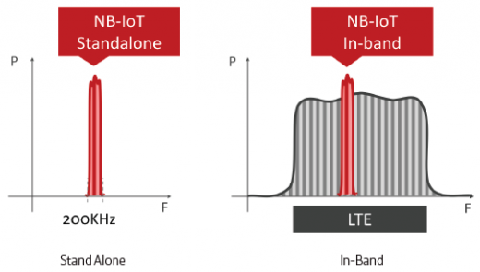
Why not GSM-R in-band of a 5 MHz LTE/NR carrier?
GSM-R
GSM-R
Flexible migration scenarios
Lower power restrictions than
a 1.4 MHz LTE/NR carrier in
919.6-921 MHz
    Effect of the additional filtering of the
    MFCN BS duplexer
More room for a receiving filter on the cab-radio at each edge of the 5 MHz channel
    250 kHz at each edge + part of the remaining 600 kHz preserved
Possibly greater capacity than a 1.4 MHz channel
NR

Slide 12
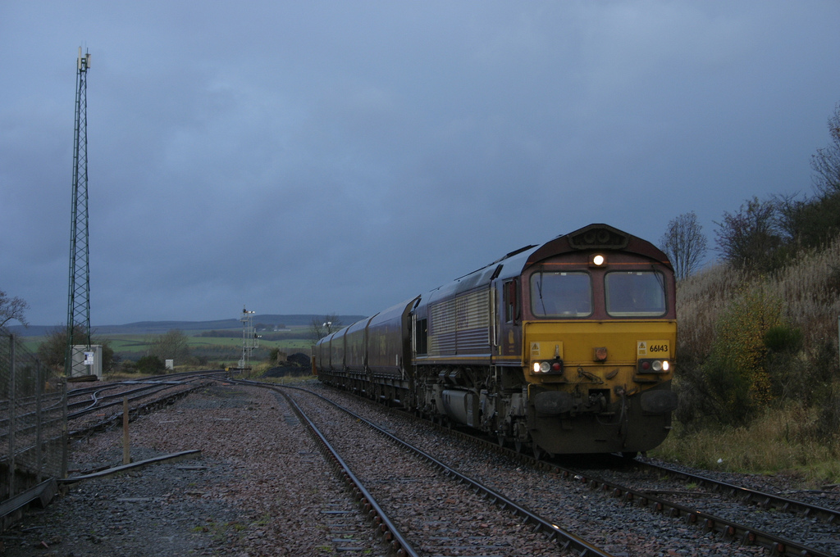
To FRMCS and beyond! A possible ending
Core band: 874.4-880 MHz / 919.4-925 MHz FDD
    Both GSM-R and FRMCS, including guard-band towards SRD
Complementary band: either 1900-1910 MHz TDD or 10 MHz in 2290-2400 MHz TDD as a tuning range
    Choice to be made based on the technical conditions to be defined
    Possible criterion: conditions compatible with a perpetual migration (beyond FRMCS)  LTE/NR may have a shorter life cycle than GSM
source

Slide 13
To FRMCS and beyond! Millimetre wave for railways
Idea submitted at the last FM56, yet to be discussed at WG FM
    Preliminary and not related to FRMCS
Identify [150] MHz for railways in the 40.5-43.5 GHz range, foreseen as a 5G band
    Avoid that railways have again to go in the MFCN “left holes”
Possible use:
    Corrective and predictive maintenance in train stations and shunting yards
    Video for telecommand in shunting yard
    Wireless backbone within a consist
    Consist-to-consist communication
    Direct communication between locomotives at each end of a freight train

Slide 14
Future of RMR
source
EC harmonisation, including FRMCS, expected in H1 2021
Urgent need of an outage criterion for FRMCS from railways!
RMR cab-radios (GSM-R/FRMCS) may need improved receiver characteristics to filter MFCN emissions above 925 MHz and SRD ones below 919.4 MHz
What about the 40.5-43.5 GHz range beyond FRMCS?

Slide 15
SRD-MG: ITS
regulation / harmonisation
Interoperable trains
Voice + ETCS
Urban Rail
CBTC
source
source

Slide 16
Radio spectrum for CBTC
Mandate from the European Commission on ITS
    Extend the upper edge of the EC harmonised safety-related ITS band (5875-5905 MHz) by 20 MHz up to 5925 MHz
    Allow other means of transport such as Urban Rail (CBTC) in addition to road transport, in the EC harmonised safety-related ITS band
Target date: March 2019 for the response

Slide 17
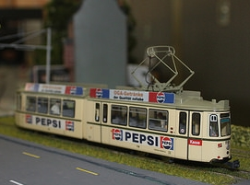
Requirements on the revision of the regulatory framework
Existing road ITS and CBTC implementations should stay available for maintenance and evolution (i.e. continued rollout)
    Existing road ITS below 5905 MHz and CBTC above 5905 MHz
Once placed into service, no modification possible to road ITS devices to fix a potential coexistence issue with CBTC
    It is the nature of a general authorisation regime
Tramways not segregated from road or pedestrian traffic shall be considered as part of road ITS
Technology neutrality
    No technology shall be imposed to CBTC

Slide 18
Coexistence between road ITS and CBTC being explored
Definition of sub-bands in which road ITS and CBTC will have priority
Prior to allow a full sharing of the 5875-5925 MHz band with a priority mechanism, the exact technical interference mitigation measures must be specified, tested and validated
    Need for a trusted solution that can be enforced
This is not possible within the time frame of the mandate
⇒ potential need for a transition period
Two options: CBTC in 5905-5925 MHz or in 5915-5935 MHz
    CBTC need: same 20 MHz during and after the transition period

Slide 19

ANFR Contact:
Vincent Durepaire
vincent.durepaire@anfr.fr
Tel: +33 1 45 18 72 14
ECC Contact: | Web: www.cept.org/ecc
ECO Nyropsgade 37, 4 DK-1366 Copenhagen Tel: +45 33 89 63 00

Slide 20
Abbreviations
E-UTRA | Evolved Universal Terrestrial Radio Access (4G)
EC | European Commission
FM | Frequency Management
INR | Interference to Noise Ratio
ITS | Intelligent Transport Systems
LRTC | Least Restrictive Technical Conditions
LTE | Long Term Evolution (4G)
MFCN | Mobile/Fixed Communications Networks
MG | Maintenance Group
NB-IoT | Narrowband Internet of Things
NR | New Radio (5G)
PMSE | Programme Making and Special Events
PT | Project Team
RMR | Railway Mobile Radio
SE | Spectrum Engineering
Sens | Sensitivity
SRD | Short-Range Devices

Slide 21
EC Decision on SRD in 874-876 MHz / 915-921 MHz
Note [5] intended for the protection of existing co-channel services, i.e. Defence and GSM-R
Note [7] intended for the protection of GSM-R in its harmonised band from SRD

Slide 22
The European Commission consulted CEPT
Extract of CEPT’s answers to the EC
    For a 3 MHz FRMCS carrier in 918-921 MHz as well as for a 1.4 MHz FRMCS carrier in 918-919.4 MHz, the power restrictions would be too stringent for a macro coverage rollout without densification. The coordination with MFCN operators would enable to operate FRMCS at a higher level, but the range of additional mitigation to be reached through coordination (rough order of magnitude 30 to 40 dB) makes unrealistic any successful coordination, taking also into account that MFCN and railway base stations are already deployed.
    In contrast, for a 1.4 MHz FRMCS carrier above 919.4 MHz, the power restrictions should leave some room for effective usage by railways.

